Slide 1







“Hands-on” introduction to reproducible research tools
Zane Billings

Slide 2
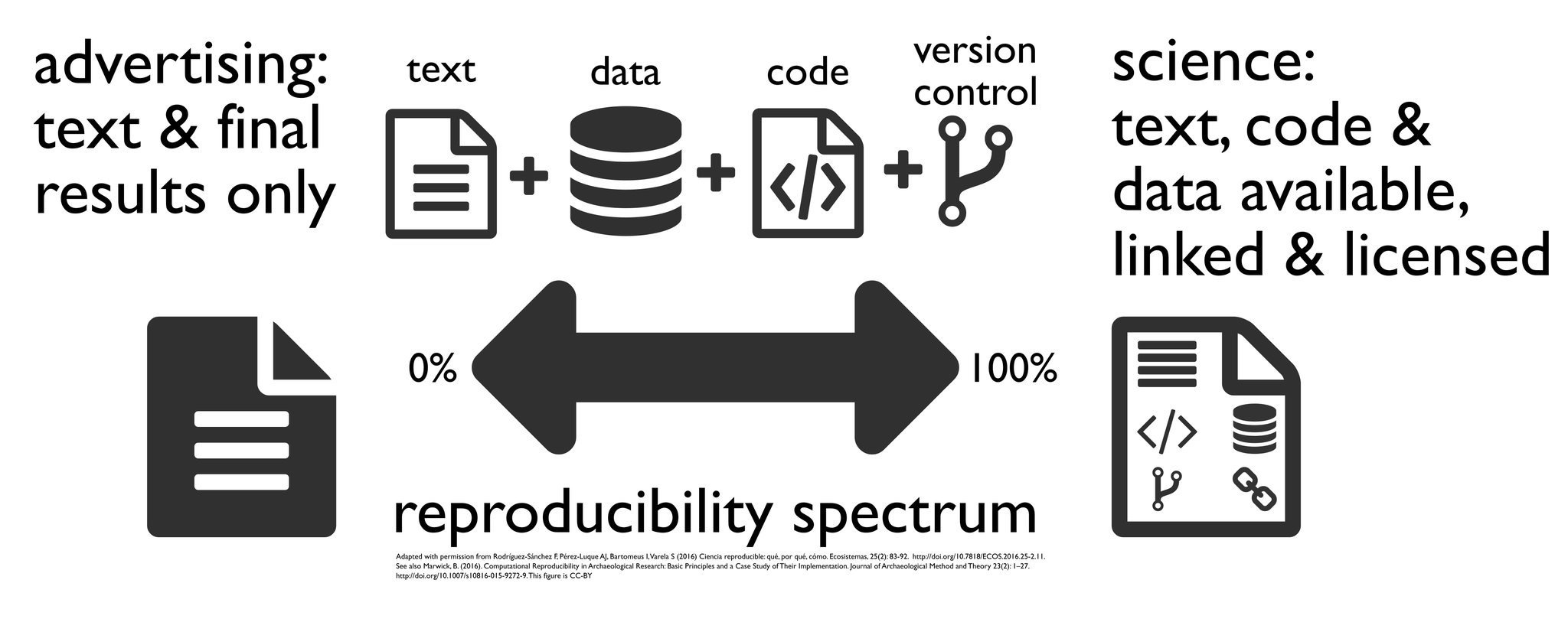
What is RR?

Slide 3
Reproducible research links
https://wzbillings.com/presentations/open-science-ceid/
https://andreashandel.github.io/MADAcourse/Open_Science.html
https://andreashandel.github.io/MADAcourse/Tools_Reproducibility.html

Slide 4
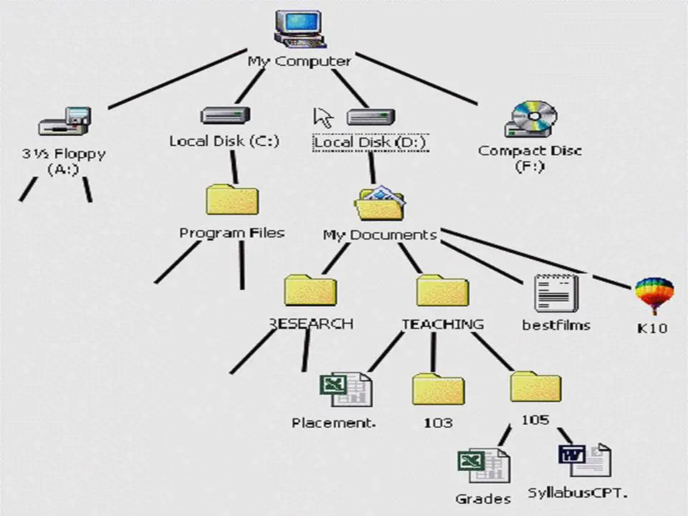
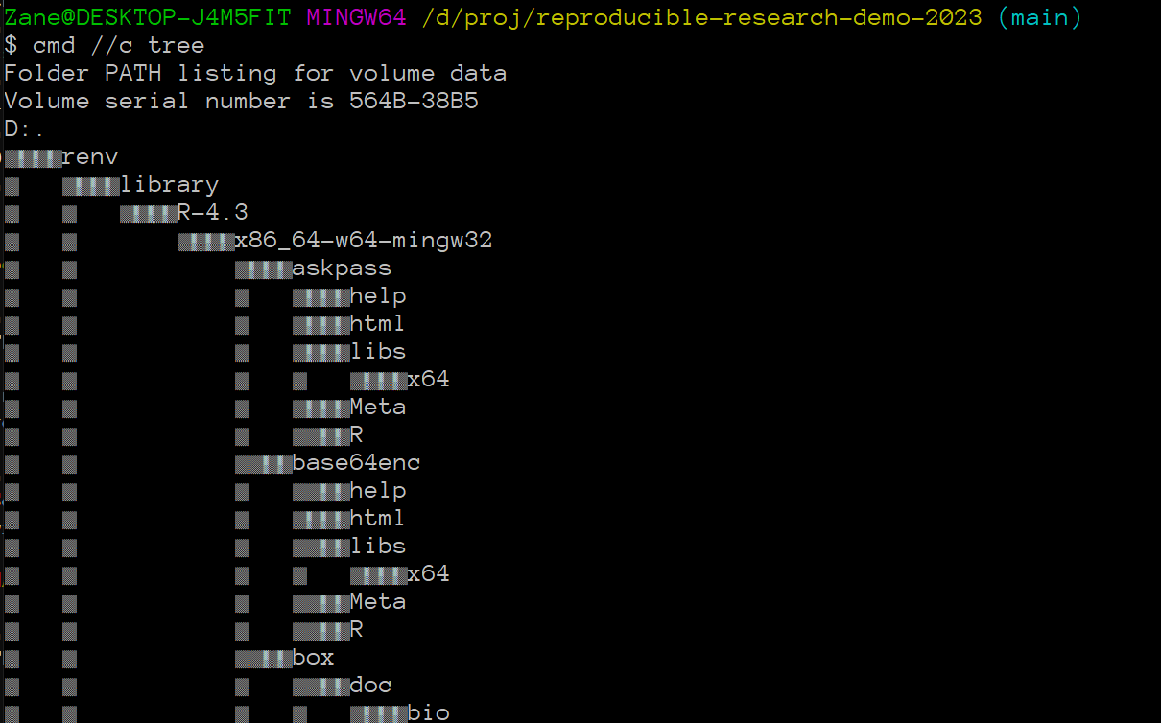
File trees and the working directory

Slide 5
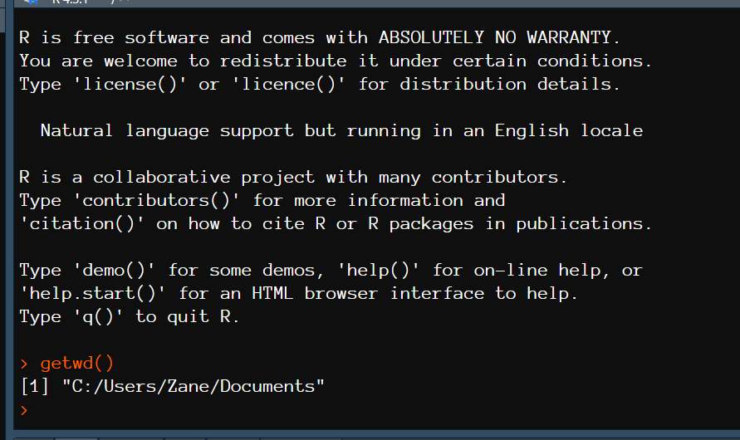
What is the working directory?

Slide 6
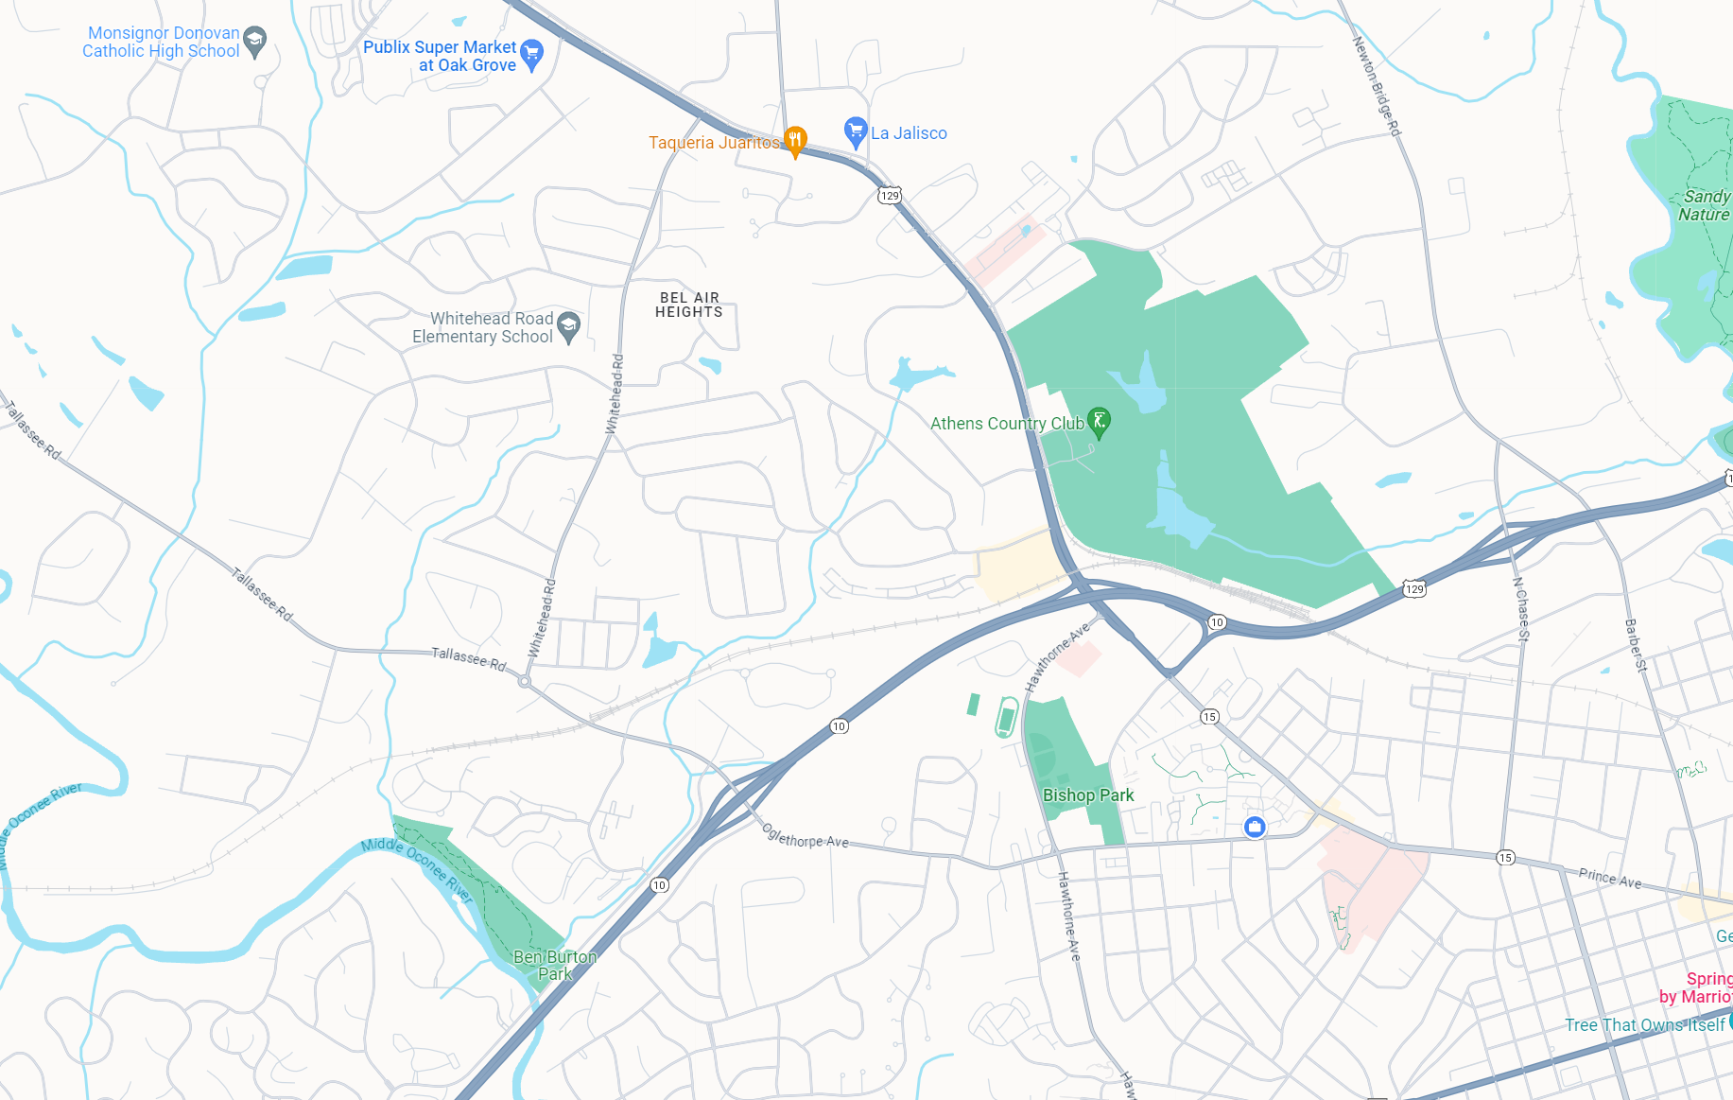

Slide 7
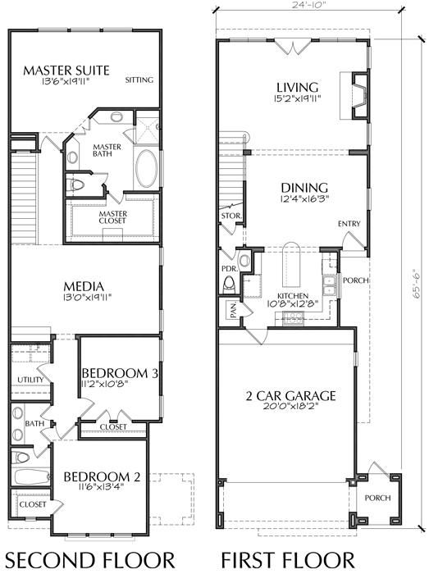

Slide 8
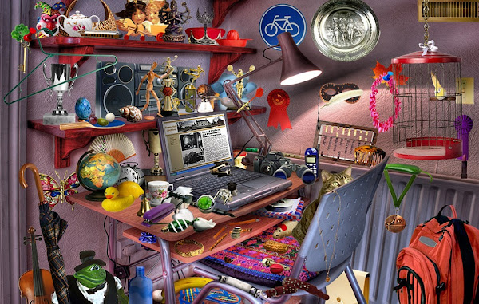

Slide 9
Working directory!

Slide 10
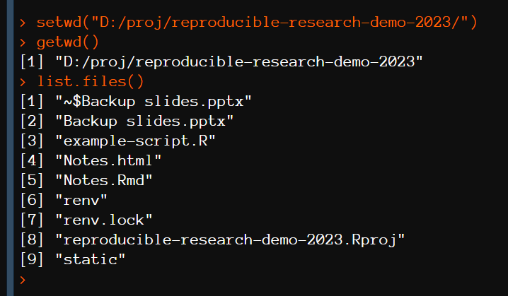
Setting the working directory

Slide 11
Just use an R project instead though
https://www.tidyverse.org/blog/2017/12/workflow-vs-script/
https://support.posit.co/hc/en-us/articles/200526207-Using-RStudio-Projects
https://here.r-lib.org/

Slide 12
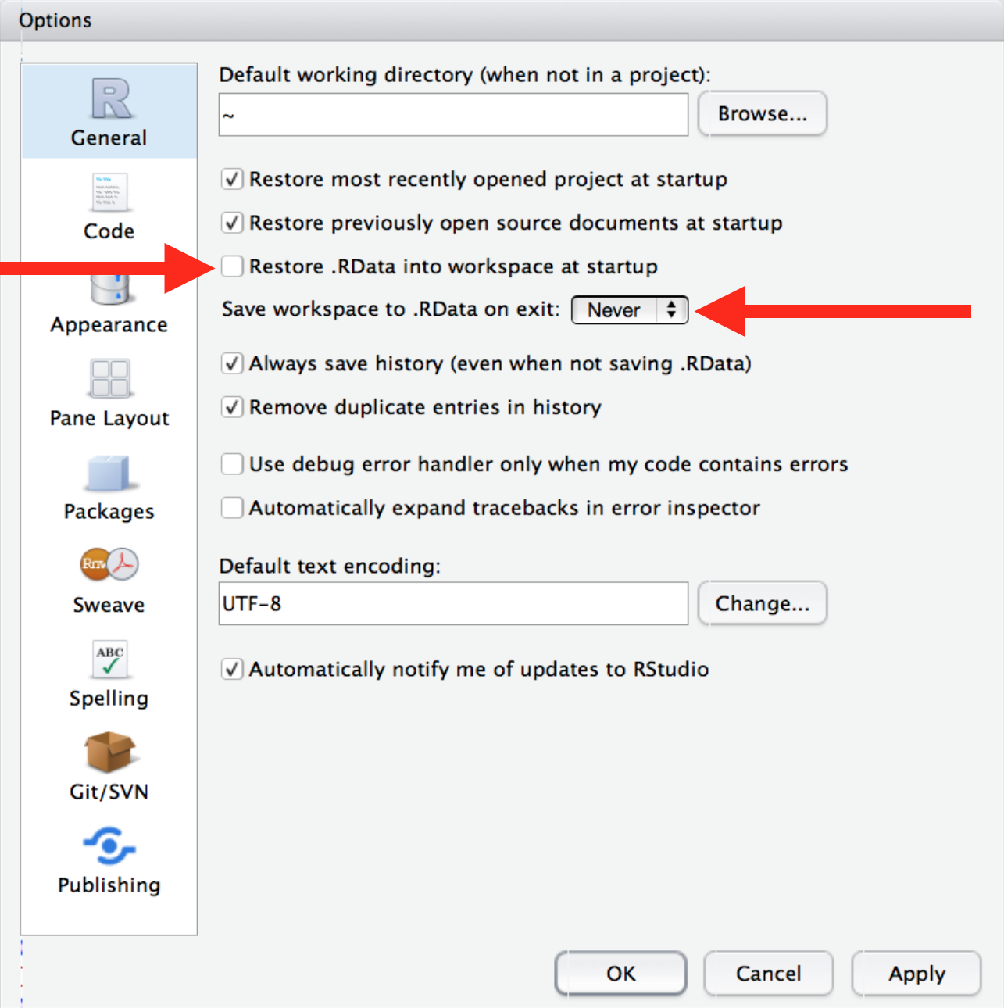
The R history
https://usethis.r-lib.org/reference/use_blank_slate.html
CRUCIAL for every new machine you use !!

Slide 13
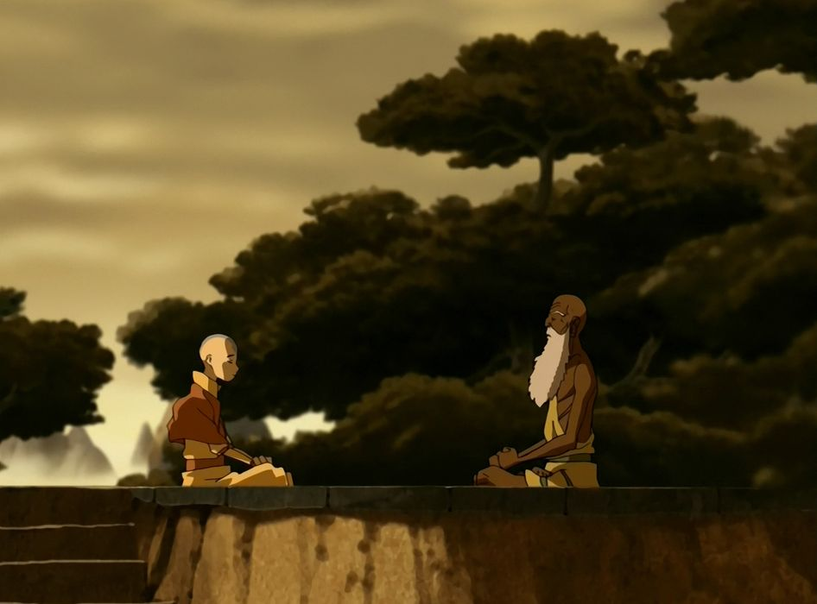

Slide 14
“The greatest illusion of this world is the illusion that the things in the R environment
are real, but only the code is real” – Guru Pathik in Avatar: the Last Airbender, probably

Slide 15
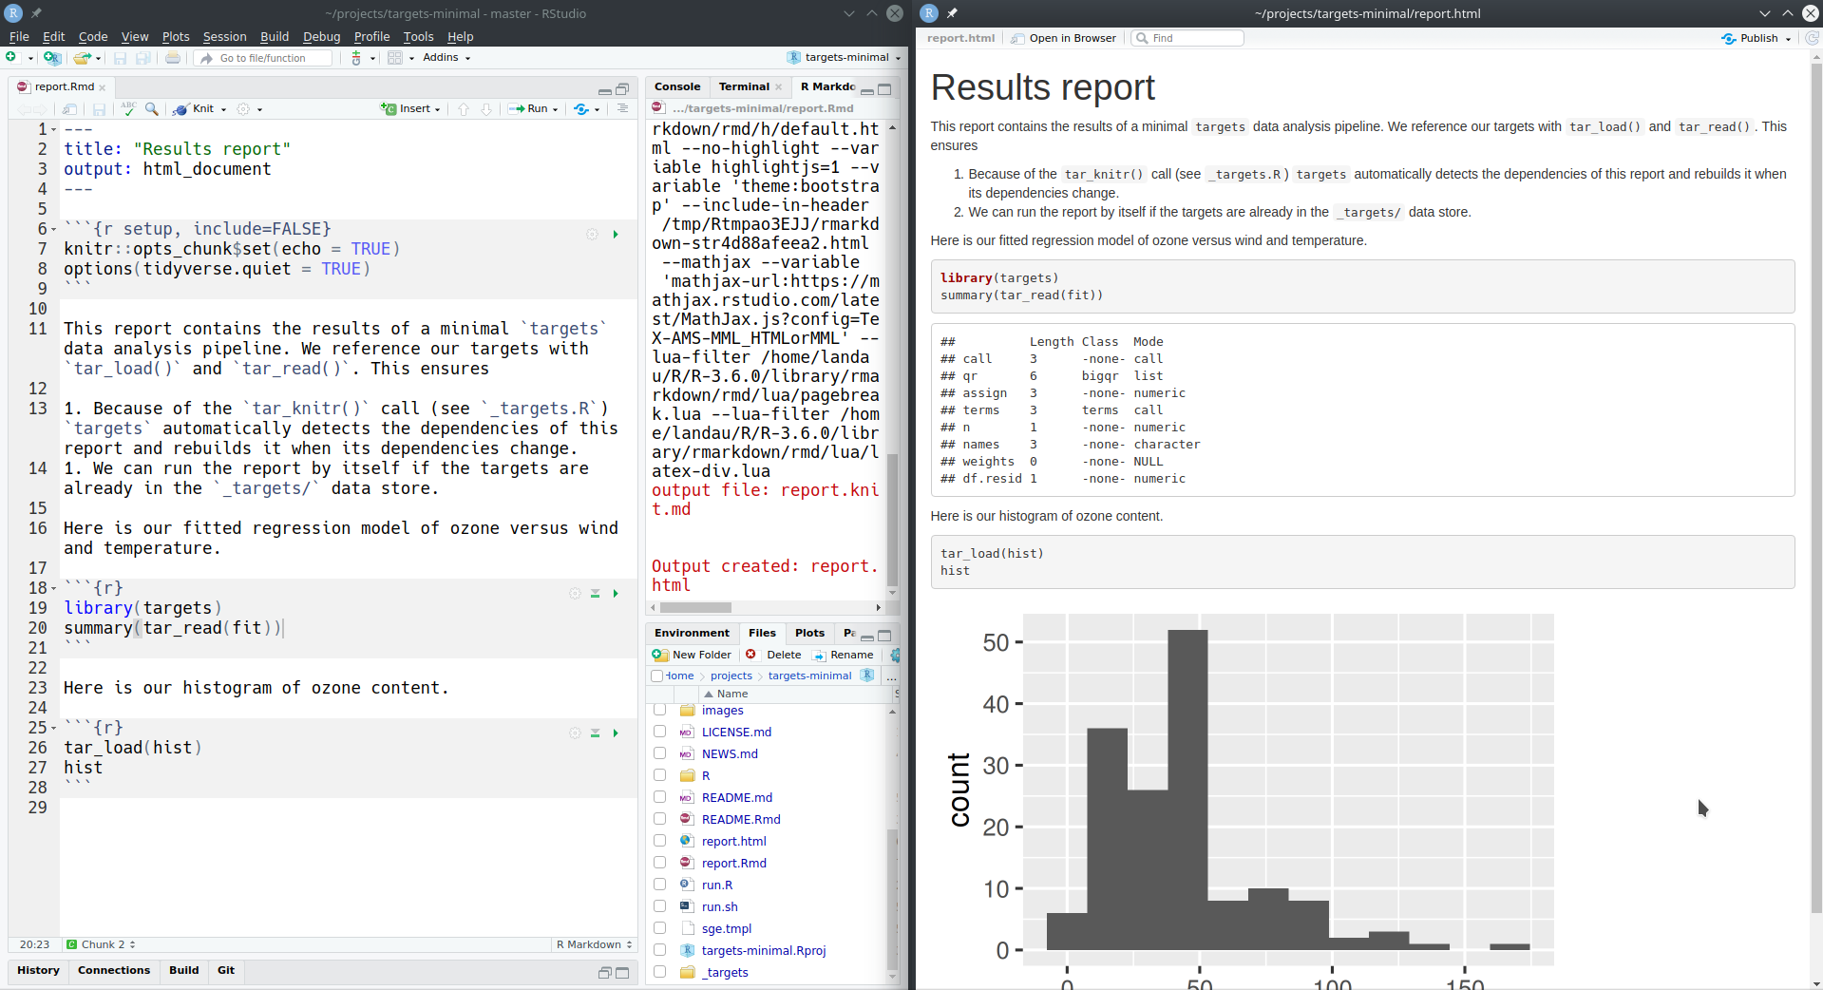
Literate programming
Source: https://books.ropensci.org/targets/literate-programming.html
https://bookdown.org/martin_shepperd/ModernDataBook/C3-Literate.html

Slide 16
Literate and modular programming
This workshop is usually 3 hours so we don’t have time for much of a programming tutorial today, so let’s look at an example instead.
https://github.com/wzbillings/Symptom-Agreement-Public

Slide 17
Bibliographies and zotero
https://www.zotero.org/
https://retorque.re/zotero-better-bibtex/
https://bookdown.org/yihui/rmarkdown-cookbook/bibliography.html

Slide 18
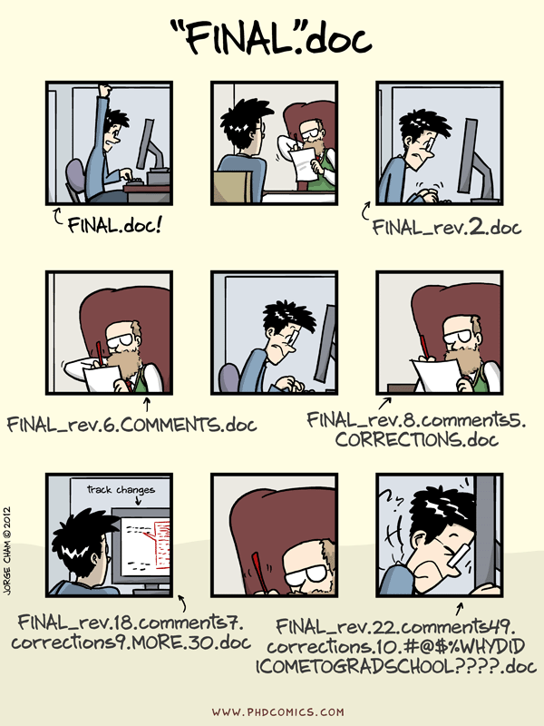
Git/GitHub
Pros: solves that problem in the comic
Cons: steep learning curve, tricky to use
Again I’ll show an example since a tutorial could take a full lecture
Recommend: https://ohmygit.org/

